Slide 1

LUNG CANCER DETECTION
Aaron Tan
Mini-Project 2
#2025-07-08-ds-pt-wa-sg

Slide 2
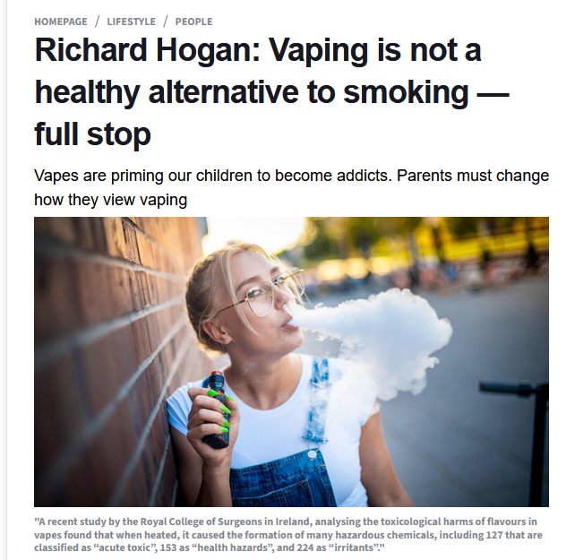
Article
💀 Toxic Chemicals:
When vape flavours are heated, they create 127 “acute toxic”, 153 “health hazard”, and 224 “irritant” chemicals.
🫁 Health Risks:
Vaping is linked to a higher likelihood of smoking uptake, respiratory problems, and mental ill-health according to long-term studies.
🚭 Misleading Safety Perception:
Many parents think “at least it’s not cigarettes,” but vapes still contain high nicotine levels and are marketed toward young people in misleading ways.

Slide 3
Agenda
Intro
Audience
EDA
ML Models
Recommendations

Slide 4

Introduction
Role Play Scenario
Picture this:
You have 24hrs in day:
Which of the following could quietly increase your risk of lung cancer?
Lighting up “just one” cigarette during stress breaks 🚬
Ignoring that dry cough that’s lasted for weeks 🤧
Working in a dusty or smoky environment without a mask 🏭
Thinking “I’m healthy, so I don’t need a check-up”, always fatigue all the time.🙈
I always coughing and short of breath everytime I do normal things🌫️

Slide 5
Introduction
Main Point?
What key features or habits do you notice that contribute to having a chance of detecting lung cancer - and how can we recognize when they start to negatively affect us?
Quiz:
Lighting up “just one” cigarette during stress breaks 🚬
Ignoring that dry cough that’s lasted for weeks 🤧
Working in a dusty or smoky environment without a mask 🏭
Thinking “I’m healthy, so I don’t need a check-up”, always fatigue all the time.🙈
E. I always coughing and short of breath everytime I do normal things🌫️
Are these everyday habits signs of high cancer risk, or
are they just low-risk routines we’ve normalised?

Slide 6

Audience
Stakeholder: Health Care Professionals
Professional Examples: Doctors, Radiologist
Increasing number of patients requiring early and accurate diagnosis of lung cancer.
Must adapt to AI-assisted diagnostic tools that enhance scan interpretation and reduce human error.
Need to understand and trust machine learning outputs to confidently use them in clinical decisions.
Responsible for communicating AI-based results clearly to patients while ensuring empathy and ethical care.

Slide 7
Audience
Why this problem worth investigating?
🫁 Lung cancer remains one of the leading causes of death worldwide, often detected only in its late stages when treatment options are limited.
🔬 Early detection can drastically improve survival rates, yet many patients are diagnosed too late due to limited screening and subtle early symptoms.
💻 AI-powered detection tools can help radiologists identify cancer patterns faster and more accurately from X-rays or CT scans.
📊 Data-driven analysis of patient and imaging data enables more reliable predictions and reduces diagnostic errors.
🌍 Social and healthcare impact: advancing detection technology supports global health goals, saves lives, and reduces the burden on healthcare systems.

Slide 8
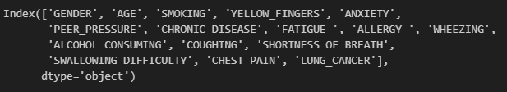
EDA
309 records | 15 features 🧠 Goal: Predict “Lung Cancer Risk” based on 15 lifestyle, health, and symptom features — whether a person is likely to develop lung cancer.

Slide 9

ML Models

Slide 10
ML Models - Baselines

Slide 11
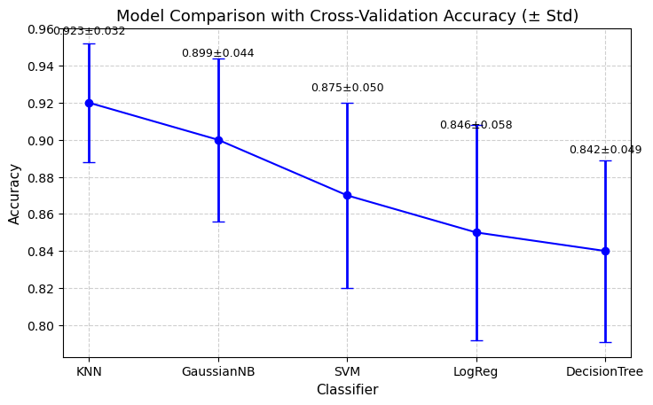
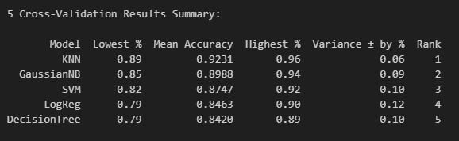
ML Models - Baselines
1. 5-Fold Cross Validation

Slide 12
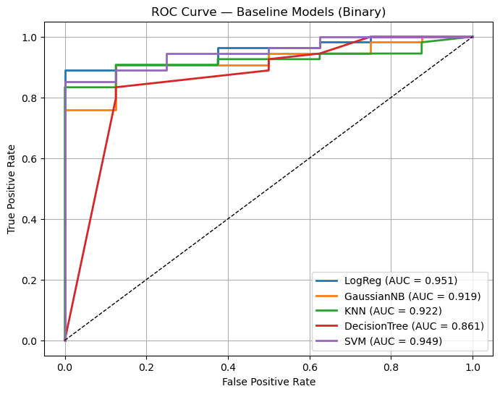
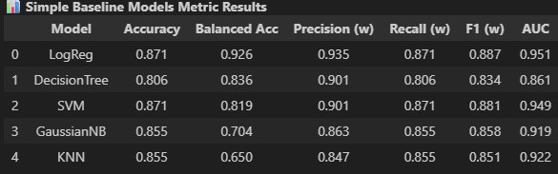
ML Models - Baselines
2. ROC Curve and AUC Comparison
Highest AUC Score: Logistic Regression Regression (0.951)

Slide 13
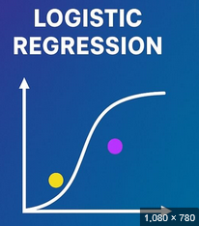
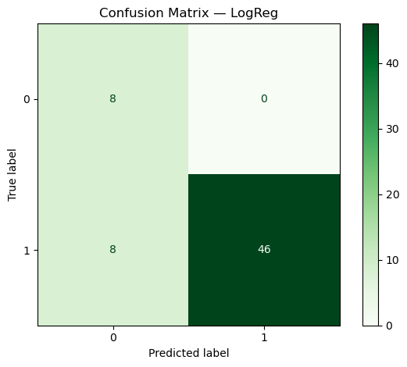
ML Models - Baselines
3. Logistic Regression Confusion Matrix Results
 | Predicted: No Cancer (0) | Predicted: Cancer (1)
Actual: No Cancer (0) | 8 ✅ (True Negatives) | 0 ❌ (False Positives)
Actual: Cancer (1) | 8 ❌ (False Negatives) | 46 ✅ (True Positives)
✅ The Logistic Regression model achieved 85% recall, correctly identifying most cancer cases.
🚫 No false positives were found (100% precision), showing strong reliability when it predicts “Cancer.”
⚠️ However, 8 cancer cases were missed (false negatives), suggesting sensitivity could still improve.

Slide 14
ML Models - Baselines
Best Model - Metrics Summary
Best Model: Logistic Regression
Summarized key metrics to help understand:
AUC 0.951 (Excellent) — AUC measures how well the model separates cancer from non-cancer cases. A perfect model = 1.0, random guessing = 0.5.
The model successfully caught about 85% (recall) of all real cancer cases.

Slide 15
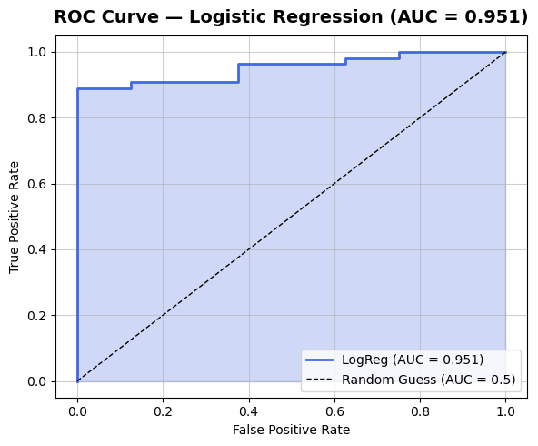
ML Models - Baselines
Best Model - Metrics Summary
Logistic Regression:
Summarized key metrics to help understand:
AUC 0.951 (Excellent) — AUC measures how well the model separates cancer from non-cancer cases. A perfect model = 1.0, random guessing = 0.5.

Slide 16
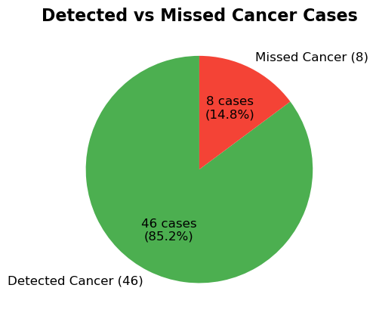
ML Models - Baselines
Best Model - Metrics Summary
Logistic Regression:
Summarized key metrics to help understand:
The model successfully caught about 85% (recall) of all real cancer cases.

Slide 17
ML Models - Ensembles

Slide 18
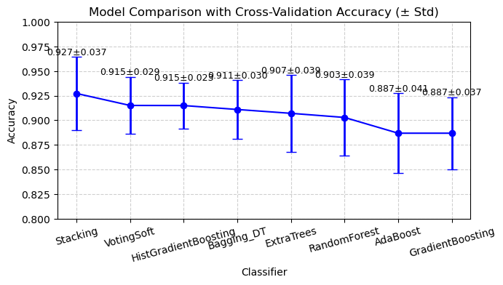
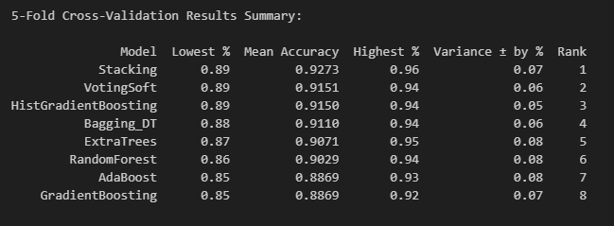
ML Models -Ensemble
1. 5-Fold Cross Validation

Slide 19
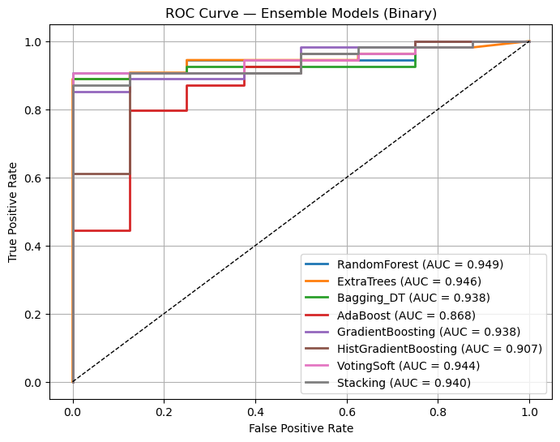
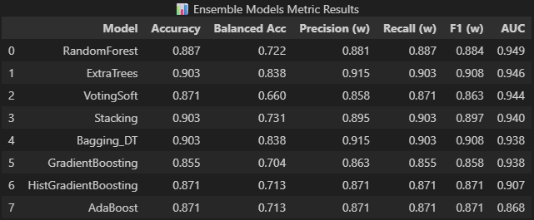
ML Models -Ensemble
2. ROC Curve and AUC Comparison
Highest AUC Score: RandomForest (0.949)

Slide 20
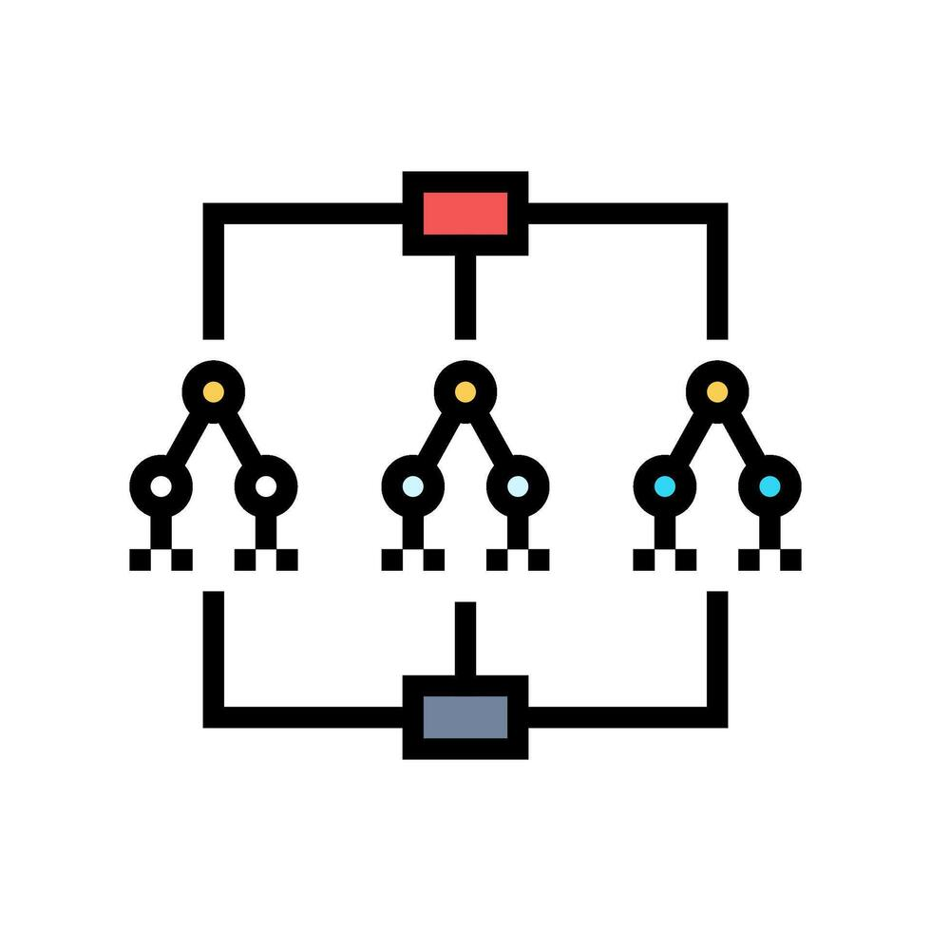
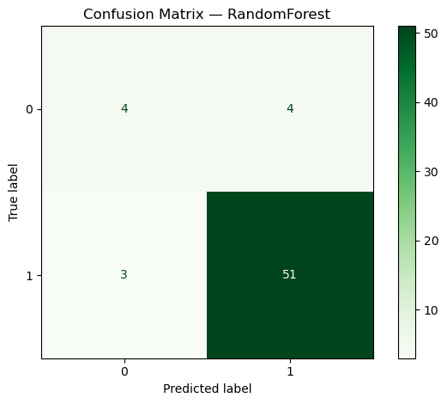
ML Models -Ensemble
3. RandomForest Confusion Matrix Results
 | Predicted: No Cancer (0) | Predicted: Cancer (1)
Actual: No Cancer (0) | 4 ✅ (True Negatives) | 4 ❌ (False Positives)
Actual: Cancer (1) | 3 ❌ (False Negatives) | 51 ✅ (True Positives)
✅ The RandomForest model achieved 94% recall, correctly identifying most cancer cases.
🚫 4 false positives were found (93% precision), showing strong reliability when it predicts “Cancer.”
⚠️ However, 3 cancer cases were missed (false negatives), suggesting sensitivity could still improve.

Slide 21
ML Models -Ensemble
Best Model - Metrics Summary
Best Model: RandomForest
Summarized key metrics to help understand:
AUC 0.949 (Excellent) — AUC measures how well the model separates cancer from non-cancer cases. A perfect model = 1.0, random guessing = 0.5.
The model successfully caught about 94% (recall) of all real cancer cases.

Slide 22
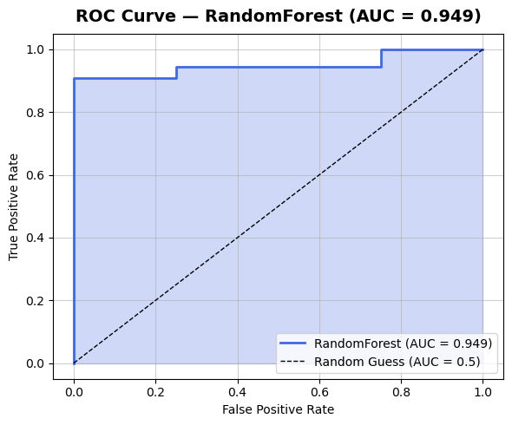
ML Models -Ensemble
Best Model - Metrics Summary
Best Model: RandomForest
Summarized key metrics to help understand:
AUC 0.949 (Excellent) — AUC measures how well the model separates cancer from non-cancer cases. A perfect model = 1.0, random guessing = 0.5.

Slide 23
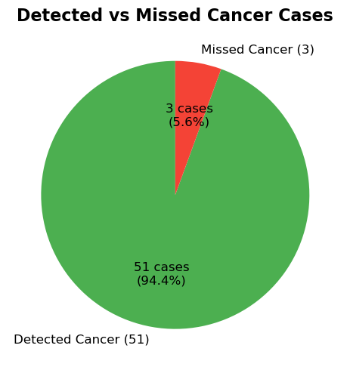
ML Models -Ensemble
Best Model - Metrics Summary
Best Model: RandomForest
Summarized key metrics to help understand:
The model successfully caught about 94% (recall) of all real cancer cases.

Slide 24
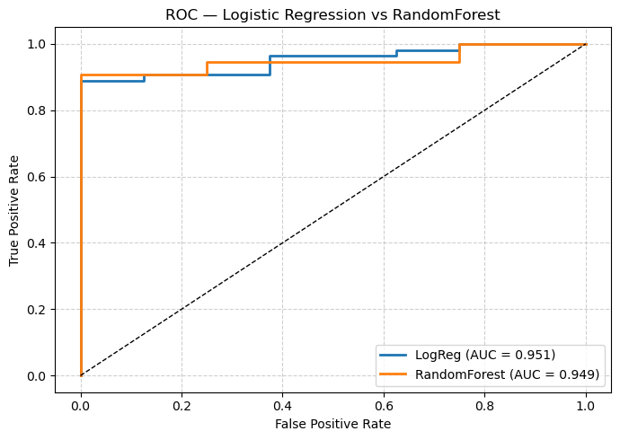
ML Models – Baseline vs Ensemble
Who wins? - Metrics Summary
🏆 Winner: Logistic Regression
Type of Model | Model | F1 | AUC
Baseline | Logistic Regression | 0.887 | 0.951
Ensemble | RandomForest | 0.884 | 0.949

Slide 25
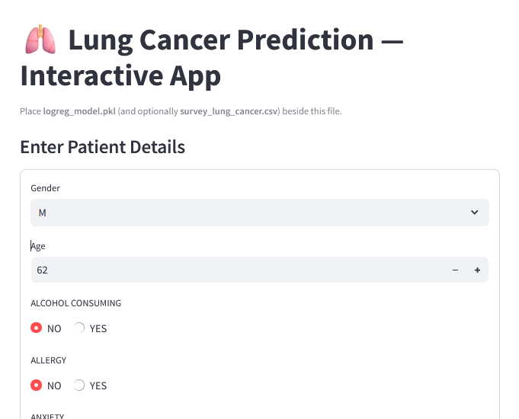
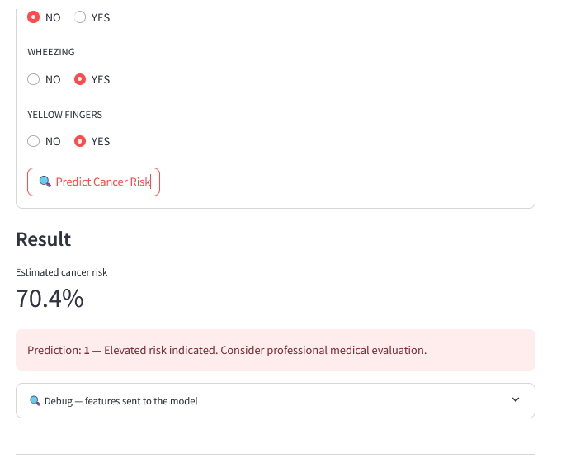
UI Application Showcase

Slide 26
Recommendations

Slide 27




The Future is Now: Tech's Role in Mental Wellness
Technology is Neutral
Embrace Supportive Tools
Our devices aren't inherently good or bad—their impact depends entirely on how mindfully and intentionally we choose to use them.
Actively seek out and utilize technologies that genuinely support your mental health, productivity, and overall wellbeing.
Take Control
You are the architect of your digital life. Set boundaries, make conscious choices, and prioritize your psychological wellness above all else.
As we navigate this digital age, remember that the power to shape technology's impact on our mental health lies firmly in our hands. Choose wisely, live intentionally, and let technology serve your highest good.

